Slide 1

Blockchain Empowered: Revolutionizing Agro-Based Supply Chain Management
Guided by
Mr. S.CHINNADURAI, M.Tech.,
Assistant Professor / CSE Dhanalakshmi Srinivasan Engineering College (Autonomous), Perambalur.
Presented by
ABINESH A - (DSUG20104005)
AJAI S - (DSUG20104008)
ARAVIND A - (DSUG20104016)
GOPI G - (DSUG20104046)

Slide 2
ABSTRACT
Agriculture, which provides jobs to 70% of rural India, faces supply chain inefficiencies causing losses up to 5.99% in cereals and 60% yield losses for farmers. Current supply chains often suffer from a lack of visibility, with only 6% of businesses .Inefficient processes and potential delays in order completion can lead to customer dissatisfaction and losses. Blockchain allows all stakeholders to access and verify the movement of goods, enhancing customer trust and satisfaction. Blockchain optimizes inventory management and logistics, reducing waste and increasing productivity, leading to cost savings.

Slide 3
OBJECTIVE
The main objective of this project is to harness the power of blockchain technology to transform India’s agricultural supply chain, with the aim of reducing inefficiencies, decreasing losses, boosting farmers’ income, and enhancing the consumer experience.

Slide 4
EXISTING SYSTEM
In the existing manual supply chain system for product sales, the process typically involves multiple intermediaries and manual record-keeping. Farmers or producers sell their products to middlemen or wholesalers, who in turn sell to retailers, and finally, the products reach the end consumers.
Each step of this process relies heavily on paperwork, phone calls, and physical inspections to track products, negotiate prices, and facilitate transactions. This manual method is prone to errors, delays, and inefficiencies, leading to challenges such as lack of transparency, difficulty in tracing product origins, and increased risk of fraud or mismanagement.
In this is RFID technology based agricultural products traceability scheme has been implemented .
QR based scheme has been implemented for product traceability .

Slide 5
DISADVANTAGES
Less secure
High maintainable cost
High traceability cost.
Increased risk of fraud

Slide 6
LITERATURE SURVEY

Slide 7
S.No | TITLE | AUTHORS NAME &YEAR | METHODOLOGY | LIMITATIONS
1 | Blockchain in the Electronics Industry for Supply Chain Management: A Survey | Shruti Jadon, Anagha Rao, Thanushree R., Netra Jagadish, and Prasad B. Honnavalli- 2024 | The implementation of blockchain technology and smart contracts to provide a decentralized and secure architecture for supply chain management in the electronics industry | This method may not be able to handle complex or dynamic scenarios that require human intervention or judgment.
2 | Securing Sensing in Supply Chains: Opportunities, Building Blocks, and Designs | Jan Pennekamp, Fritz Alder, Lennart Bader, Gianluca Scopelliti, Klaus Wehrle, and Jan Tobias Mühlberg-2024 | The framework for securing supply chains consists of four components: secure sensing, data storage, data sharing, and data processing. It explores four scenarios for end-to-end security in IoT-based supply chains. | The methodology may face issues in complex supply chains, challenges in trust management among actors, and potential performance and cost limitations, especially with blockchain-based solutions.
3 | Blockchain Technology to Support Agri-Food Supply Chains: A Comprehensive Review | Marco Fiore and Marina Mongiello-2023 | The paper uses a systematic literature network analysis (SLNA) to review blockchain technology’s application in agri-food supply chains. It explores the use of blockchain for traceability, transparency, and trust | The challenges including policy and regulations, scalability, less skilled human resources, high investment, interoperability, lack of training for industries and stakeholders, and absence of developer tools.
4 | Blockchain and Smart Contracts for Telecommunications: Requirements vs. Cost Analysis | Nima Afraz, Francesc Wilhelmi, Hamed Ahmadi, and Marco Ruffin-2023 | The paper uses blockchain technology and smart contracts for telecommunications networks. It employs cost analysis and performance evaluation methodologies to study two use cases: 5G slice brokering and federated learning | The main limitation is the need for more resources for high-throughput use cases. Also, factors like cost, performance, and scalability of blockchain infrastructure deployment are often not adequately considered.
5 | Cross-Border E-Commerce Supply Chain Decision-Making Considering Out-of-Stock Aversion Risk and Waste Aversion Risk | XIN XU AND SHAOJIE ZHOU-2023 | The paper uses prospect theory to analyze risk preferences in cross-border e-commerce supply chains. It conducts a numerical analysis to examine the impacts of these risk preferences on decision-making | The model’s assumption of perfect information and accurate estimation of risk preference coefficients, which may not reflect real-world behavior.

Slide 8
PROPOSED SYSTEM
The proposed system envisions a technologically advanced and secure approach to agriculture-based supply chain management through the implementation of blockchain.
This innovative system aims to streamline and fortify the entire supply chain by leveraging blockchain decentralized and tamper-resistant nature.
It will facilitate transparent and traceable recording of agricultural data, from cultivation practices to the sale of products. Farmers input data on product quality, quantity, and details into the blockchain network, which is then securely recorded and accessible to all stakeholders.
The integration of smart contracts will automate and enforce agreements between stakeholders, reducing the need for intermediaries and minimizing inefficiencies.
In the enhancing data security and ensuring a trustworthy supply chain, the proposed system seeks to empower the agricultural industry with a resilient, efficient, and transparent foundation for sustainable growth.

Slide 9
ADVANTAGES
Increased Efficiency: Blockchain can streamline logistics and optimize inventory management, leading to increased efficiency.
Reduced Risk: Blockchain’s decentralized and immutable nature can reduce risks associated with sourcing and transportation.
Enhanced Trust: Blockchain offers unprecedented transparency and traceability, fostering trust among all stakeholders.
Improved Collaboration: Blockchain can improve collaboration among various entities involved in the supply chain.
Data encryption and security

Slide 10
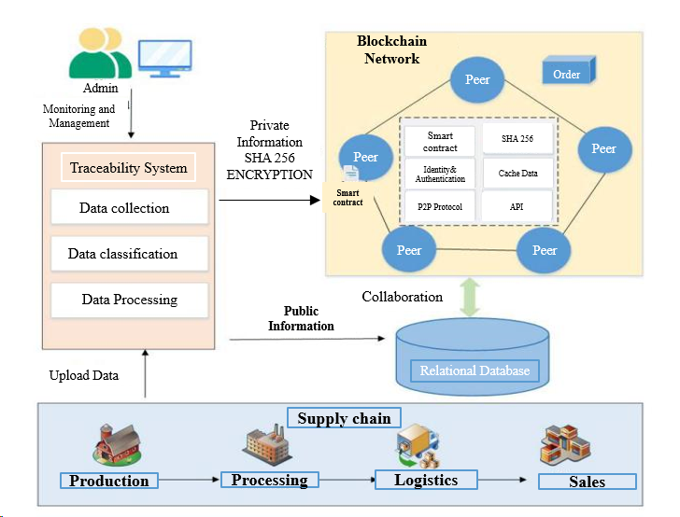
ARCHIECTURE DIAGRAM

Slide 11
CONCLUSION
In conclusion, the integration of blockchain technology into agriculture-based supply chain management presents a transformative solution marked by transparency, security, and efficiency.
The decentralized and tamper-resistant nature of blockchain, the system ensures the trustworthy recording of agricultural data, fostering transparency throughout the supply chain.
With the added benefits of enhanced security, automated processes through smart contracts, and reduced risk of fraud, this innovative approach not only strengthens the integrity of the agricultural supply chain but also paves the way for a sustainable and technologically advanced future in agriculture.
The adoption of blockchain stands poised to revolutionize how stakeholders engage in and benefit from the agricultural ecosystem, marking a significant leap towards a more resilient and efficient industry.

Slide 12
FUTURE ENHANCEMENT
Implementation of digital technologies, including the Internet of Things (IoT), big-data analytics, artificial intelligence (AI), and related information and communications technologies (ICT), are key enablers in modern industries.
They provide valuable insights, enhance decision-making, improve operational efficiency, and facilitate communication and information sharing, thereby revolutionizing various sectors, including the agro supply chain management.
These technologies, when integrated with blockchain, can make the supply chain more efficient, transparent, and resilient.

Slide 13
THANK YOU

